Slide 1
Phase 2 - Project
AGENDA xc
Intro To Business & Opportunity
Methodology
3 Recommendations
Potential Future Next Steps
Extra Credit (if time permits)
Notes:
Good afternoon, today going to be covering the following

Slide 2
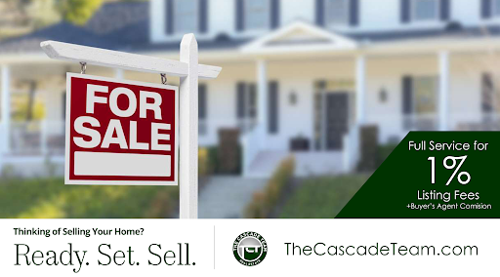

The Business
King County
REALITY
Goal: Increase Revenue From Seller Commissions
Notes:
King County Reality is looking to increase its revenue from Seller Commissions:

Slide 3


How?
Help Agents Identify “Most Valuable” Home Improvements Projects, for recommendations to sellers
2. Help Agents Set “Better” Prices… augment CMA process
Notes:
The boss felt there were two areas that could be improved
Helping Agents make suggestions to sellers on how increase the price of homes prior to selling
Getting better at generating sales prices, especially when Comps not appropriate or available

Slide 4


Business Value
“Smarter” Agents
Better Recommendations = Higher Prices = Commissions
Setting Better Prices = Getting True Market Value
Notes:
Short term – increase current revenue
But also smart agents able to help create best possible selling scenario

Slide 5
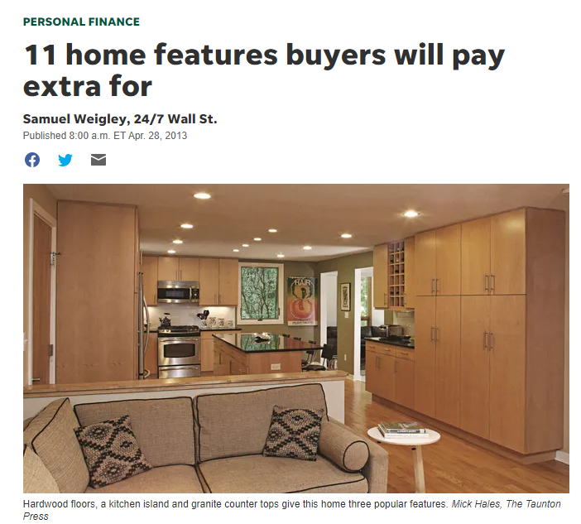
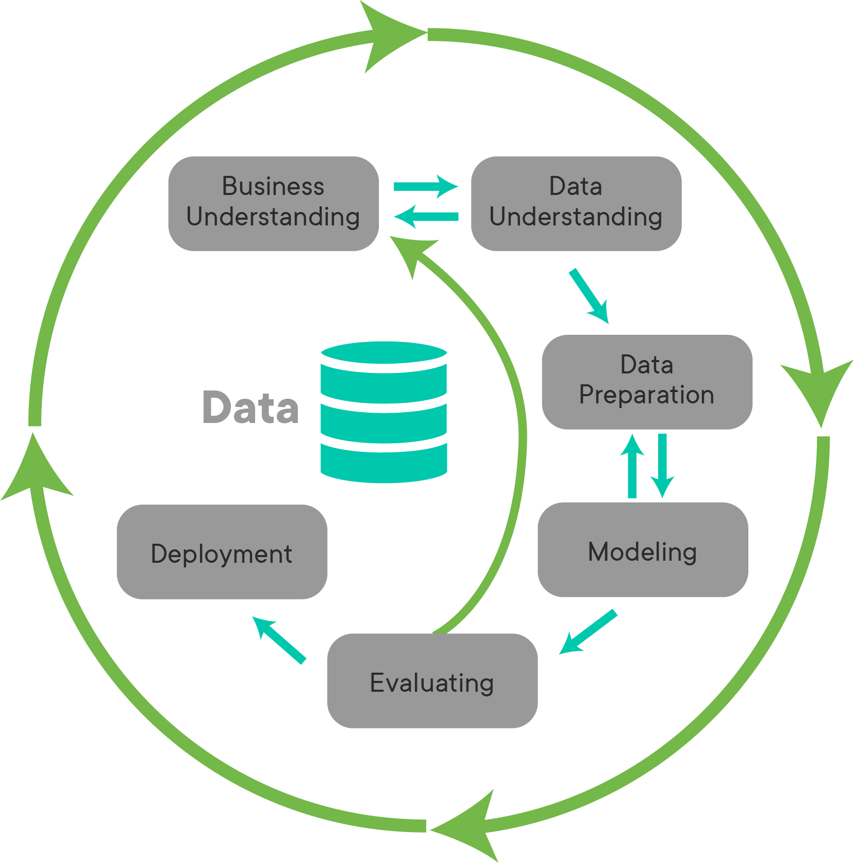

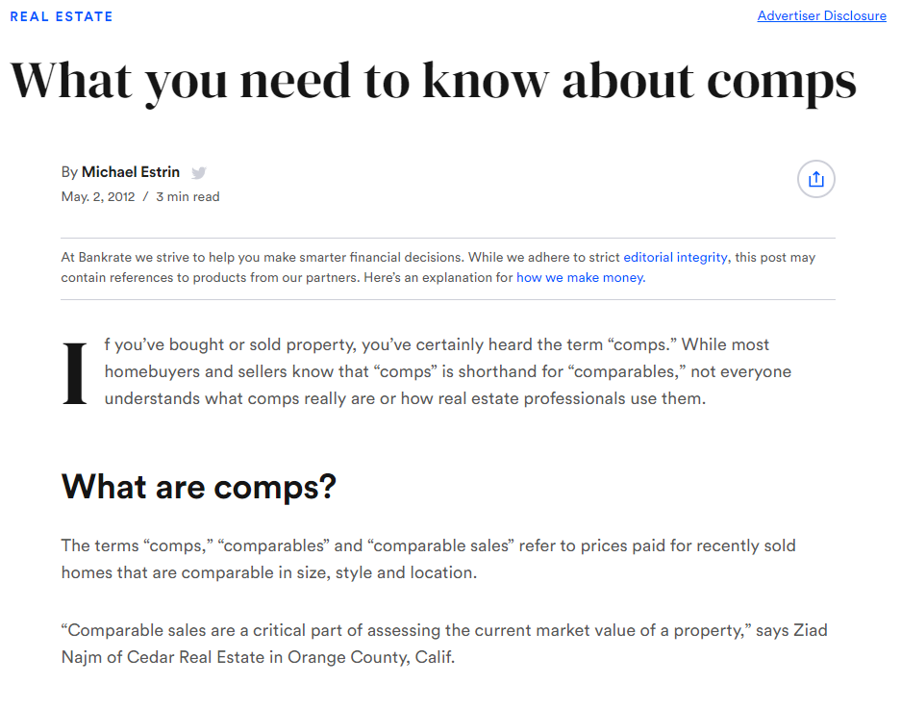


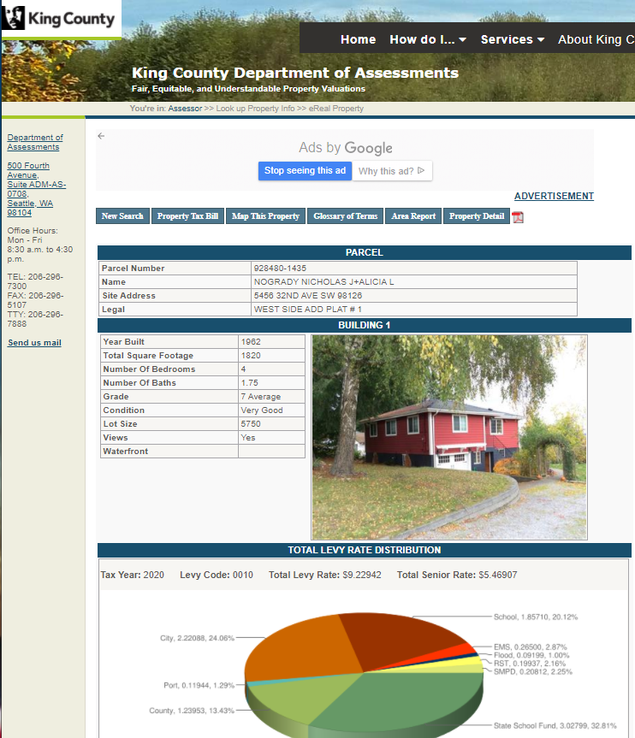
Methodology
Business Understanding
3 Recommendations
1 – Physical Factors - “controllable”
2 – Location Factor - “influenceable”
3 – Consider a new Pricing Factor
Pricing via CMA
Notes:
So how are we going to help?
- First need to understand the business?
1. What features drive home prices and how do agents set prices currently (comparative market analysis)
2. In terms of data - Location, Location ,Location - So I brought in some location based features
3. Also we found some data around helping me understand individual home better – in Tax Assessor Records. So I scraped that data
In terms of data prep and modeling as shown in the diagram applied an iterative approach, ensuring I adhered to liner regression assumptions
Based on that I felt comfortable making recommendations in the 3 following areas:
1. Physical factors – fairly controllable
2. Location factors – influenceable at best, but are a longer-term focus
3. Pricing factor
So with that lets get into my recommendation to our Agents!

Slide 6
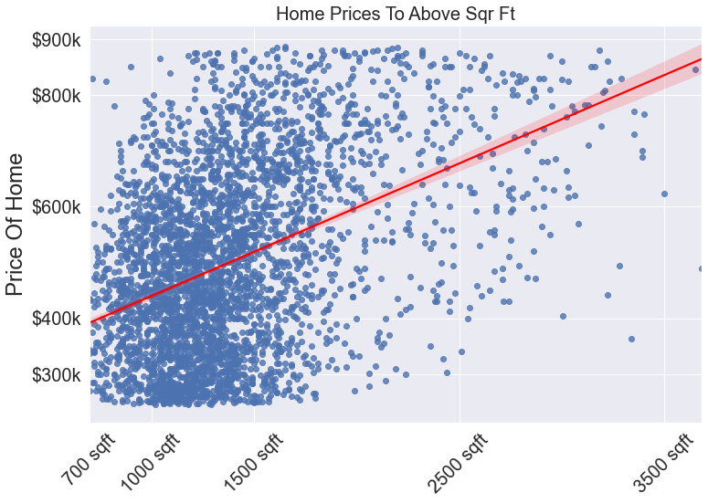
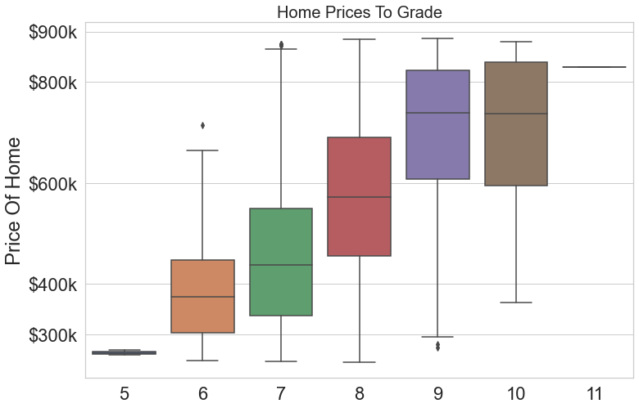
Recommendation 1: Augment Physical Features
1. # Main-Level Finished Square Feet
2. Grade “Specialness” of Home
Construction and Design, 7 = Average older sub-divisions
+100 Sqft
Grade 7
+ ~$22K
+ ~ $4K
+1 Grade*
*Grade 8+ = better materials in both the exterior and interior finish work, architectural design, solid woods, bathroom fixtures and more luxurious options.
Notes:
So physical features – The two that had the biggest weights are: Finished square ft & Grade – Obvious as these increase so do prices of homes.
But what you might not know is specificity:
Our model suggests:
1. For every increase of 100 sqr footage – you should see an increase in about $4k in home prices
2. For every increase in grade here 7 → 8 had a $22k impact. For additional information.

Slide 7
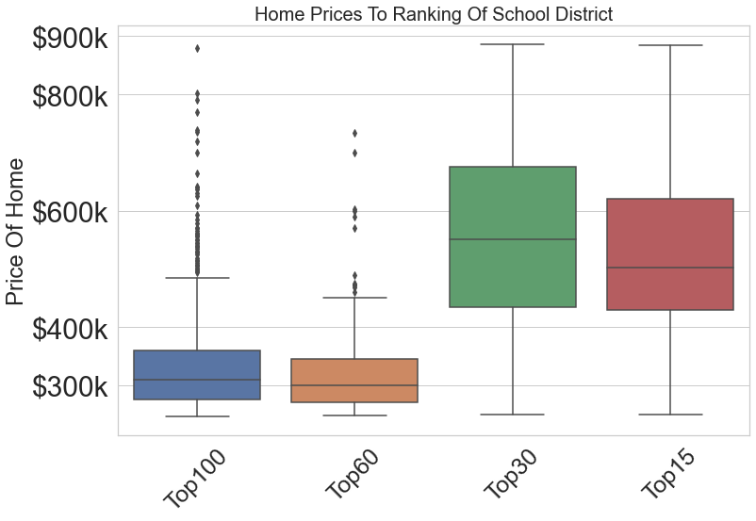
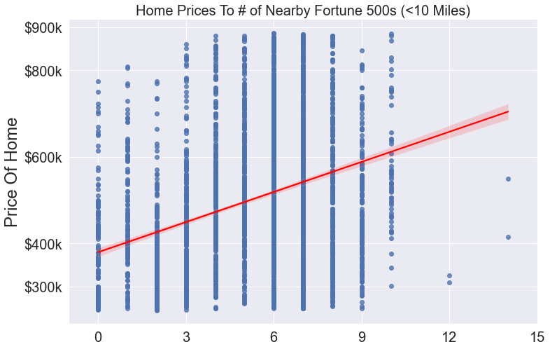
Recommendation 2: Work to Impact “Influenceable” Factors
1. School District
2. # Nearby Fortune 500’s*
Top 60
+ ~ $88K
0 F500s
+ ~ $53K
+30
+1-3
*Nearby = < 10 Miles From Home
Notes:
What about factors that are equally as impactful but harder make happen… Hence the descriptor “influenceable” these are really more location based features…
The two that had the most weights in my model were
1. School district
2. # Of FF with 10 miles
Like the previous recommendation this is fairly obvious but in terms specific impact in terms of dollars my model suggestions
Going from Top 60 to Top 15 = ~ $88k difference in predicted price when we put that change into the model.
And going from 0 to 3 + FF within 10 miles of your home ~ approx. $53k.
Now I realize this is not something that is controllable “hence” the categorization = influenceable. But something an agent can do is inform sellers that invesing in school district can have a big impact and if there are memorandums or other city wide votes on allowing companies to enter a nearby region it will certainly increase the value of your home

Slide 8

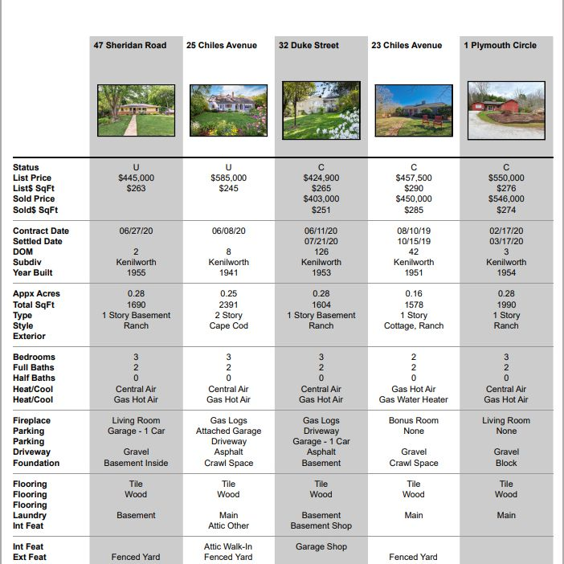
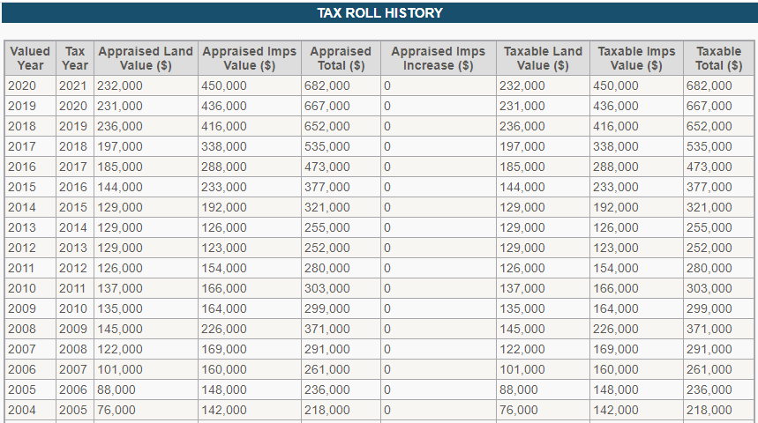
Recommendation 3: Setting “Better” Prices…Augmenting CMA
Comparative Market Analysis (CMA)
- Home Features, Condition, Location, Competition
Adding Assessor Appraisals
12/3/2014
$471,000
Assessor Appraisal Feature
200% >
Next Feature
Notes:
So now recommendation #3, which is really about setting better prices. I know the tried and true is the CMA. Current CMA focuses on the previous features we discussed…. I never saw any source suggest looking at assessor values to help estimate pricing. But our analysis suggests agents would be well served to also review assessor evaluations. Let walk you through an example: this home sold in 2014, reviewing 2013 can be very insightful in estimating prices:
It had approx. 200% larger weight than the next closest feature which was livable sqrt footage
So what does that mean. It means that assessor appraisals is a good feature to use to help increase predictive power.

Slide 9
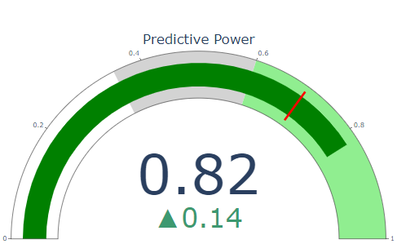
Predictive Power
= Models ability to explain variability in the data being predicted
40%
60%
20%
Medium
80%
Low
High
0
100%
Increase after adding Previous Yr Assessor Appraisals
Notes:
Predictive Power
Predictive Power – Models ability to explain variability in the data being predicted
1. So for the first two areas we focused on Physical and Influenceable – they created a model where 68% of the value was explain in the model
2 When we added our Assessor Appraisals, we jumped to .82% - which make your confidence in its predictions increase. This could be important in situations where perhaps relevant comps are not obtainable

Slide 10
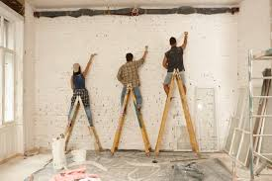

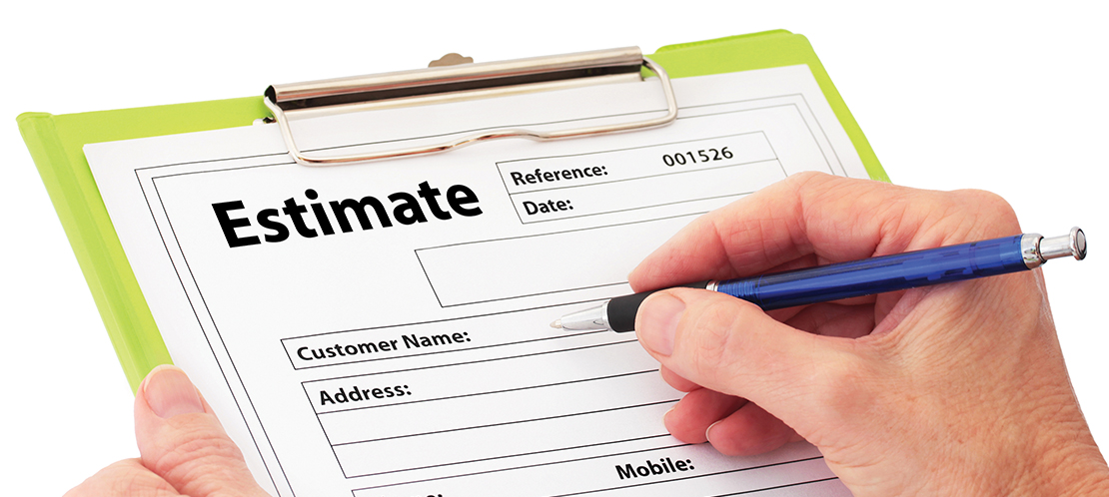
Summary of Recommendations
Increase Seller Commissions By Coaching Sellers To:
Focus on controllable and influenceable features
Look To Non-Traditional Sources When Setting Prices
Notes:
So summary of recommendations

Slide 11

Future Work/ Next Steps
Augment current model
Study homes with greatest variance between actual & predicted
Add additional interaction
# of Attractions, Inflation Factors, Other
Develop additional models for more niche homes
(<$200k, >$900k, Waterfront, Other)
Notes:
So next steps….

Slide 12

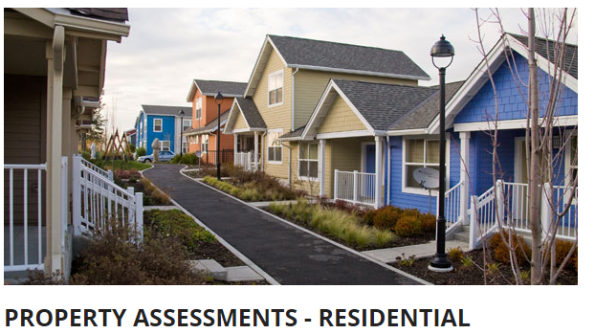
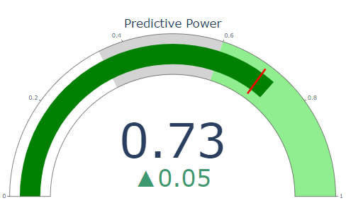

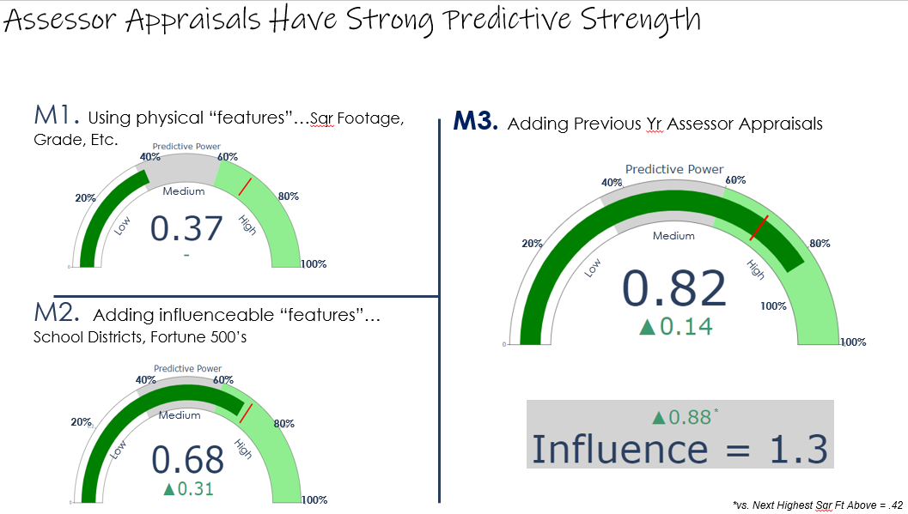

EXTRA CREDIT –
1. How Do Assessor Establish Appraisals?
2 How Well Does our Model Predict Assessor Appraisals?
???
Our Model Suggests!
?
Web Site Suggest
Most Influential Features
Sqr Ft Above -.85
School District - .43
Etc,
40%
60%
20%
Medium
80%
Low
High
Land and improvements
Comps (Sales and market trends)
Cost to reproduce/ replace
CAUTION! - On site inspection every 6 years
100%
https://www.kingcounty.gov/depts/assessor/PropertyTaxAssessments/ResidentialPTA.aspx
Notes:
Now you might be asking…. What do Assessors to create appraisals?
1. The web site suggest – things we would expect – land, improvements, etc.
And This played out in our Model - “physical” and location based features dominated the model. We found our model predicts 73% of variability in their appraisals,
Now if you comp the 73 to our second model that had the same data and features and had a lower predictive power of 68 on actual sales price, This suggestions that buyers find value in a property’s intangible qualities, vs. assessor based on more tangible factors.
One caution in using the assessor values, while it does change with inflation every year. An appraiser is not out to the house every year to revalue potential improvements so if changes have been made to the home you are setting the price for made need to adjust those numbers some to reflect potential changes.

Slide 13

Thanks For Your Time and Consideration!

Slide 14
Appendix

Slide 15
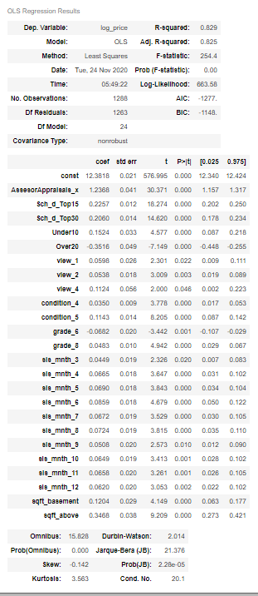
Model Results:
Measures - goodness-of-fit - 82% of our predicted price can be explained by our model features, 18% may be cause by random error
“Does This Mean?”
Notes:
Bias in the model - If the expected value of the estimator equals the population parameter, the estimator is an unbiased estimator.
If the expected value of the estimator does not equal the population parameter, it is a biased estimator.
coefficient estimates and predicted values can have larger margins of error around them. That’s why you don’t want to include too many terms in the regression model!

Slide 16
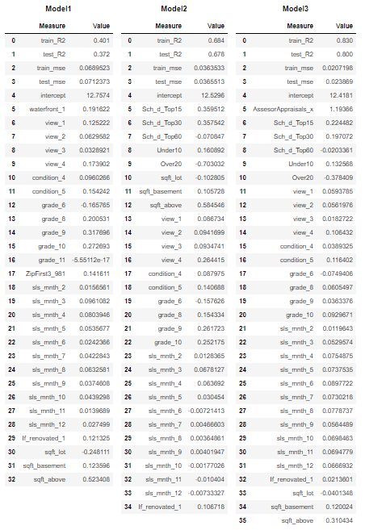
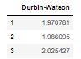
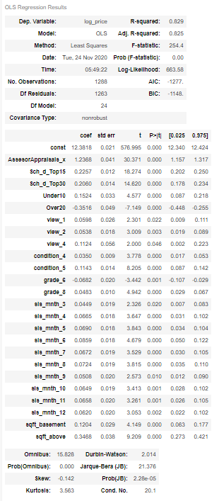
Model Progression
Model 4 Optimized Using #Backward Elimination

Slide 17
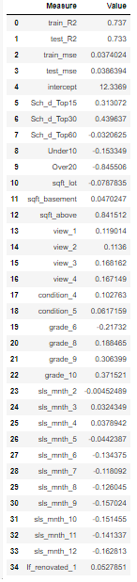
Assessor Model

Slide 18
Definition of Average Home

Slide 19
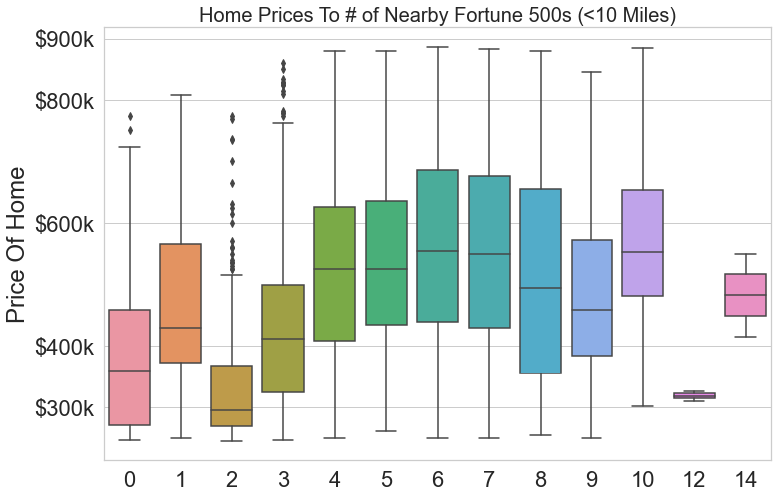

Slide 20
BUILDING GRADE
 | Represents the construction quality of improvements. Grades run from grade 1 to 13. Generally defined as: 1-3 Falls short of minimum building standards. Normally cabin or inferior structure. 4 Generally older, low quality construction. Does not meet code. 5 Low construction costs and workmanship. Small, simple design. 6 Lowest grade currently meeting building code. Low quality materials and simple designs. 7 Average grade of construction and design. Commonly seen in plats and older sub-divisions. 8 Just above average in construction and design. Usually better materials in both the exterior and interior finish work. 9 Better architectural design with extra interior and exterior design and quality. 10 Homes of this quality generally have high quality features. Finish work is better and more design quality is seen in the floor plans. Generally have a larger square footage. 11 Custom design and higher quality finish work with added amenities of solid woods, bathroom fixtures and more luxurious options. 12 Custom design and excellent builders. All materials are of the highest quality and all conveniences are present. 13 Generally custom designed and built. Mansion level. Large amount of highest quality cabinet work, wood trim, marble, entry ways etc.

Slide 21
https://info.kingcounty.gov/assessor/esales/Glossary.aspx?type=r#g
BUILDING CONDITION
 | Relative to age and grade. Coded 1-5. 1 = Poor- Worn out. Repair and overhaul needed on painted surfaces, roofing, plumbing, heating and numerous functional inadequacies. Excessive deferred maintenance and abuse, limited value-in-use, approaching abandonment or major reconstruction; reuse or change in occupancy is imminent. Effective age is near the end of the scale regardless of the actual chronological age. 2 = Fair- Badly worn. Much repair needed. Many items need refinishing or overhauling, deferred maintenance obvious, inadequate building utility and systems all shortening the life expectancy and increasing the effective age. 3 = Average- Some evidence of deferred maintenance and normal obsolescence with age in that a few minor repairs are needed, along with some refinishing. All major components still functional and contributing toward an extended life expectancy. Effective age and utility is standard for like properties of its class and usage. 4 = Good- No obvious maintenance required but neither is everything new. Appearance and utility are above the standard and the overall effective age will be lower than the typical property. 5= Very Good- All items well maintained, many having been overhauled and repaired as they have shown signs of wear, increasing the life expectancy and lowering the effective age with little deterioration or obsolescence evident with a high degree of utility.

Slide 22
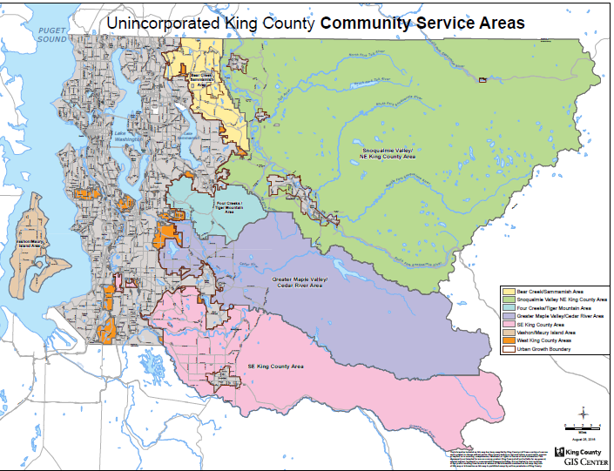

Slide 23
Recommendation 1: Supproting data
# Main-Level Finished Square Feet
~ $4K
1382 A_sft
+100 Sqft
1482 A_sft
$362,807
$366,606
Grade “Specialness” of Home
~$22K
Grade 7
+1 Grade
Grade 8
$362,807
$385454
Sadv
Notes:
So my first recommendation is around “controllable” features. Agents can influence what elements of a house sellers focus on prior to sell. Given the data we had available, these two features had the most weight/ predictive power on home prices. Main level – Finished sqare ft. You can see in the graph as square footage increases, prices also increase. But what you can not tell from the graph is that: For every increase I 100 sqr footage – x happens, and any thing we can do to improve condition… changing a homes from condition 3 → 4 had the following impact

Slide 24
Earlier versions

Slide 25

Methodology
3 Recommendations
1 – Physical Factors - “controllable”
2 – Location Factor - “influenceable”
3 – Setting “Better” Prices…Looking beyond CMA
Business Understanding
CMA
Notes:
So how are we going to help?
- First need to understand the business? What features drive home prices and how do agents set prices currently (comparative market analysis)
With a base knowledge in hand, look at the data, see what we have, determine if we have enough and or if we need more?
Based on my research – we needed more data – especially location based data (given we had long and lat (location, location, location). So I brought in school districts & rankings, number of attractions, number of fortune 500 ‘s and there location
Also during my research I found some data from the assessors that allowed me to get a look at the actual houses that I was valuing and noticed other data that could be useful for estimating prices, especially in circumstances where comps are not available, which in our case was real given window was only 12 months, and finding true comps was not easy. So I scraped that data as well
In term of data prep & modeling – looked for outliers, nulls, and the key assumptions related to linear regression – Linear relationships, Multicollinear, Normality, Homescedicity. Built model in iterative manner, tweaking the dataset. Adding new features with each iteration, and interpreting the coefficients to see if they logically made sense from what I learned about the business. After more 4 iteration I felt comfortable with the results so decided to move forward
Based on the data (features & results) I determine what I could effectively answer and made adjusts to the business opportunities, ensure my model was able to make data drive recommendations. My recommendations are 3 fold –
What “controllable“ physical features should agents encourage their clients to focus on,
what “influenceable” features should agents focus on
And then I heard some much about comps but what if comps are not comps? develop additional information on how agents can help set better prices when perhaps comps are not available or are not comprable

Slide 26
Methodology
Business Understanding
3 Recommendations
1 – Physical Factors - “controllable”
2 – Location Factor - “influenceable”
3 – Consider Assessor Appraisals when setting price
CMA
Notes:
So how are we going to help?
- First need to understand the business? What features drive home prices and how do agents set prices currently (comparative market analysis)
Based on my research and understanding the data, it was obvious we need location data – Location, Location ,Location - So I brought in location based features: school districts & rankings, number of attractions, number of fortune 500 ‘s and there location
While doing this scrapping, I found some data from the assessors that allowed me to get a look at the actual houses that I was valuing and noticed other data that could be useful for estimating prices, So I scraped that data as well
In term of data prep & modeling – looked for outliers, nulls, and adhered to key assumptions related to linear regression – Linear relationships, Multicollinear, Normality, Homoscedicity.
Built model in iterative manner, tweaking the dataset. Adding new features with each iteration, and interpreting the coefficients to see if they logically made sense from what I learned about the business.
After more 4 iteration I felt comfortable with the results so decided to move forward
Based on the data (features & results) I determine we could effectively answer what features help predict prices so I have two recommendations around that:
What “controllable“ physical features should agents encourage their clients to focus on,
what “influenceable” features should agents focus on
And then third I heard so much about comps in setting prices but what if comps are not comps? My Assessor appraisal data could be a good surrogate. So have a recommendation around that as well
So with that lets get into my recommendation to our Agents!

Slide 27
Recommendation 1: Augment Physical Features
1. # Main-Level Finished Square Feet
2. Grade “Specialness” of Home
Construction and Design, 7 = Average older sub-divisions
+100 Sqft
Grade 7
+ ~$22K
+ ~ $4K
+1 Grade*
*Grade 8+ = better materials in both the exterior and interior finish work, architectural design, solid woods, bathroom fixtures and more luxurious options.
Notes:
So my first recommendation is around “controllable” features. Agents ability to influence what elements of a house sellers focus on fixing tweaking prior to sell. Given the data we had available, there were two features that had the most weight/ predictive power on home prices.
Main level – Finished sqare ft. You can see in the graph as square footage increases, prices also increase. But what you cannot tell from the graph is specificity: Our model suggests For every increase of 100 sqr footage – you should see an increase in about $4k in home prices, which is something agents can use to help coach prospective sellers
The second area is grade – which really refers to construction and design – 7 is your average home, and anything we can do to improve on the grade makes a big difference… as you can see as grade goes up so does the average sales prices. Based on our model changing a homes from grade 7 → 8 had a $22k impact. For additional information.
8+ = better materials in both the exterior and interior finish work, architectural design with extra interior and exterior design and quality, Generally have a larger square footage. woods, bathroom fixtures and more luxurious options.
So these are just a few of the “controllable” features seller can focus on to increase the price of there home

Slide 28
Recommendation 2: Work to Impact “Influenceable” Factors
1. School District
2. # Nearby Fortune 500’s*
Top 60
+ ~ $88K
0 F500s
+ ~ $53K
+30
+1-3
*Nearby = < 10 Miles From Home
Notes:
What about factors that are equally as impactful but harder make happen… Hence the descriptor “influenceable” these are really more location based features…
First we looked at school district. You can see the mean prices for home located in top 60 vs top 15 are over $100k difference. In fact in our model we saw an $88k difference in predicted price when we put that change into the model.
Our second influenceable feature is the number of FF within 10 miles of your home increased price approx. $53k.
Now I realize this is not something that is controllable “hence” the categorization = influenceable. But something an agent can do is inform sellers that invesing in school district can have a big impact and if there are memorandums or other city wide votes on allowing companies to enter a nearby region it will certainly increase the value of your home

Slide 29
Recommendation 3: Setting “Better” Prices…Augmenting CMA
Comparative Market Analysis (CMA)
- Home Features, Condition, Location, Competition
Adding Assessor Appraisals
12/3/2014
$471,000
Assessor Appraisal 200% >
Next Feature*
Notes:
So now recommendation #3, which is really about setting better prices. I know the tried and true is the CMA. But agents would be well served to also review assessor evaluations from the previous year, sold this home sold in 2014, reviewing 2013 can be very insightful... Especially, if COMPs are not available or valid. Why do I say this?
It had approx. 200% larger weight than the next closest feature which was livable sqrt footage
So what does that mean. It means that assessor appraisals is a good feature to use to help predict a price of a home… more so than even above square footage and can be used in setting and evaluating prices… especially if comps are not available.

